Slide 1
AI-Based Cryptocurrency Price Prediction
Risk management in a highly volatile and evolving new market
Bilal Afzal
Ming Ye
Samuel Lavallée
Wan Yi
Vladimir Estévez
Notes:
Vladimir, bilal, ming, sam, wan

Slide 2
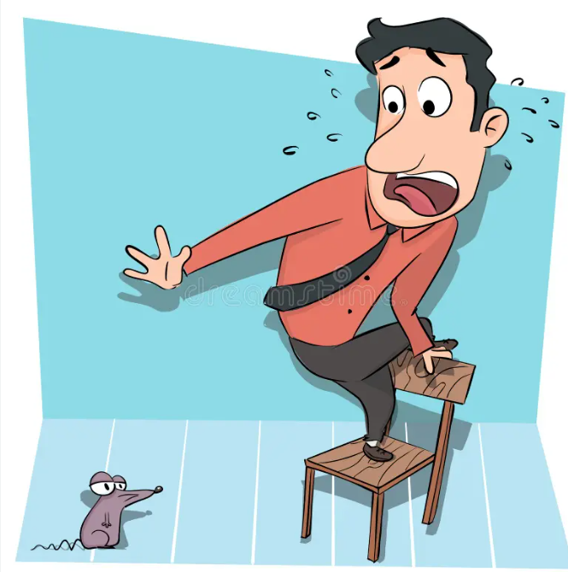
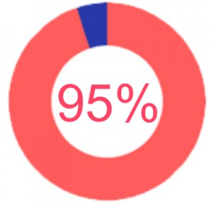

The Problem
Difficulties trading
Lost Profit off Volatility
Low Userbase
Approximately 95% of crypto traders lose money trading.
The market moves in small unpredictable increments which are lost opportunities for consistent small profits.
Retail traders are afraid of cryptocurrency trading
Notes:
samuel

Slide 3
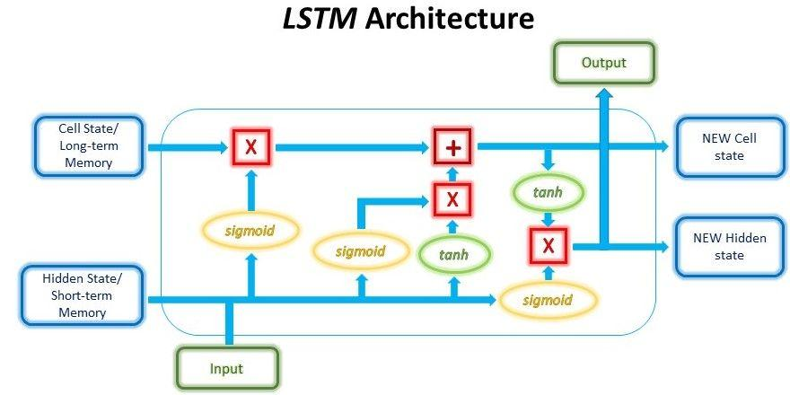
What is LSTM ?
An artificial recurrent neural network architecture.
Has feedback connections and can process not only single data points, but also entire sequences of data.
Capable of learning order dependence in sequence prediction problems.
Notes:
bilal

Slide 4
Why LSTM and not other Models?
Long Short-Term Memory (LSTM) Networks: LSTMs are designed to capture long-term dependencies in time series data.
They are well-suited for cryptocurrency price prediction due to their ability to retain information over long sequences and model temporal patterns effectively.
With memory cells designed to remember relevant information over varying time intervals, LSTMs excel in identifying short-term fluctuations and long-term trends within the volatile cryptocurrency market.
Notes:
bilal

Slide 5
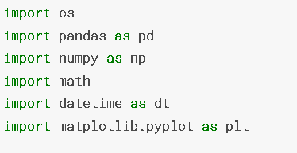
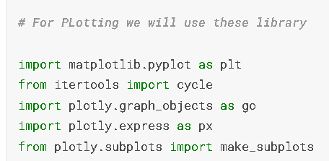
Libraries
Notes:
Ming

Slide 6
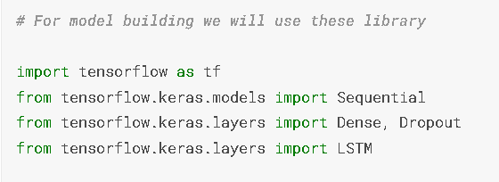
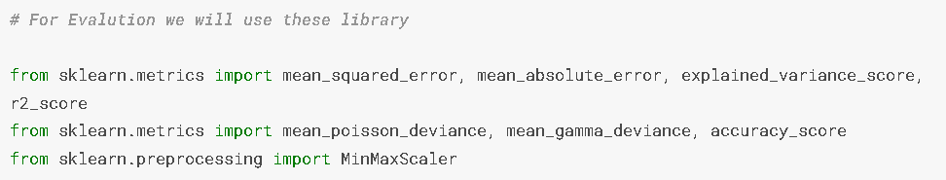
Libraries
Notes:
Ming

Slide 7
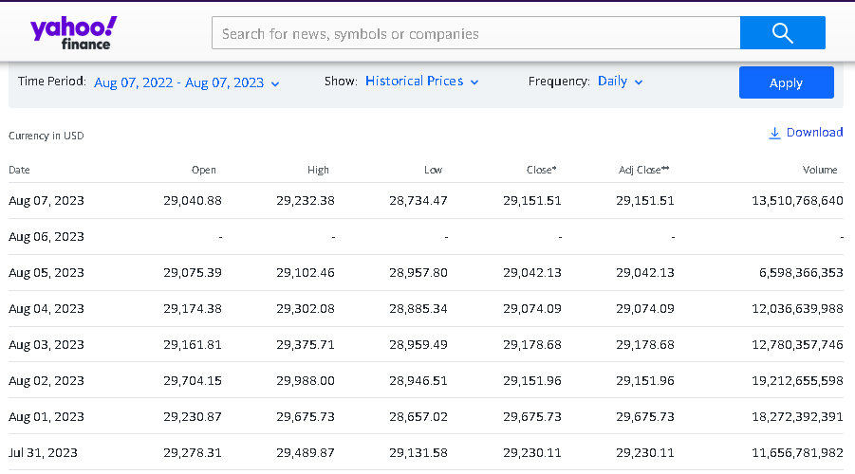
Loading Dataset
Notes:
Ming

Slide 8
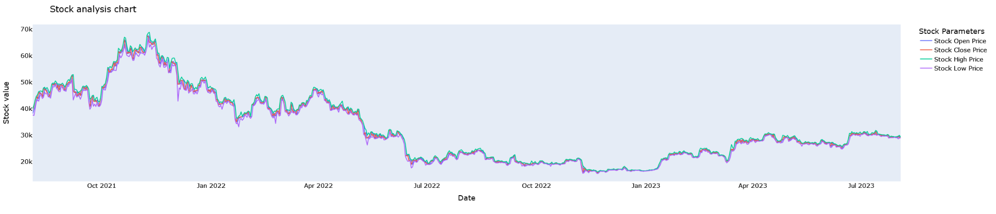
Data Analysis
Graph depicting Highest, Lowest and Opening and Closing price of each day of the year.
Have a concrete perspective of our data.
Visualize what our prediction should look like
Notes:
Ming

Slide 9
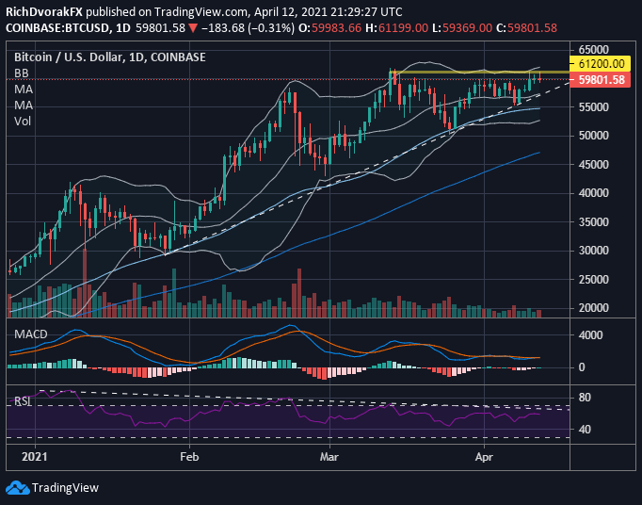
Building LSTM Model
Preparing Data for Training and Testing:
We are just considering 1 year data for training data, to avoid big price fluctuation.
We will be only be considering Close and Date, since we are predicting the Close value of BTC.
Notes:
Ming

Slide 10
Normalizing Data
The goal of normalization is to change the values of numeric columns in the dataset to use a common scale, without distorting differences in the ranges of values or losing information.
We will also be deleting the Date value since we only care about predicting the closing price.
Notes:
Ming

Slide 11
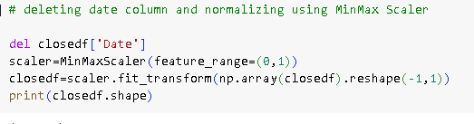
Normalizing Data
For each value in a feature, MinMaxScaler subtracts the minimum value in the feature and then divides by the range. The range is the difference between the original maximum and original minimum. MinMaxScaler preserves the shape of the original distribution.
Notes:
Ming

Slide 12
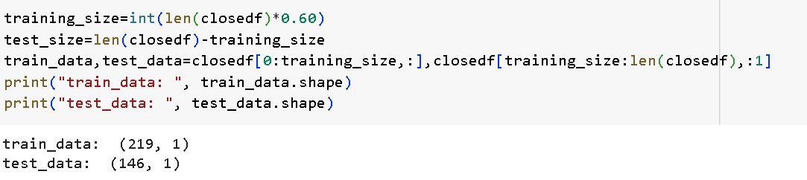
Slicing data into
Training set and Testing set
We keep the training set as 60% and 40% testing set
Notes:
ming

Slide 13
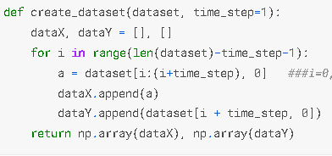
Data Transformation
Transform the Close price based on Time-series-analysis forecasting requirement, for this example we will be using 15.
First, convert the array into a dataset matrix
Notes:
Bilal

Slide 14
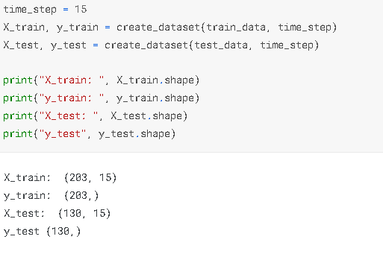
Data Transformation
First, convert the array into a dataset matrix.
Notes:
bilal

Slide 15
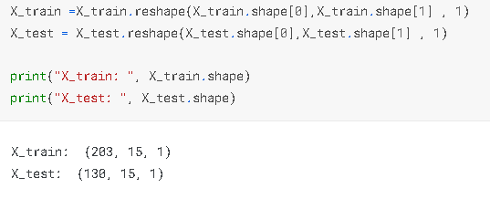
Data Transformation
Reshape input to be [samples, time steps, features] which is required for LSTM
Notes:
bilal

Slide 16
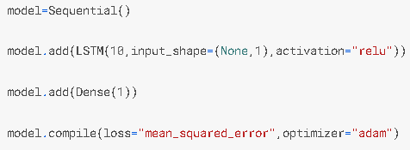
Building the Sequential LSTM Model
LSTM Layer,
10 specifies the number of LSTM units (also called cells or neurons) in this layer.
input_shape=(None, 1) defines the input shape of the layer. The first dimension (None) represents the batch size, and the second dimension (1) represents the number of time steps in each input sequence.
activation="relu" sets the activation function for the LSTM units to Rectified Linear Unit (ReLU), which introduces non-linearity into the network.
Notes:
bilal

Slide 17
Building the Sequential LSTM Model
Dense Layer,
1 specifies the number of units/neurons in this dense layer.
Notes:
bilal

Slide 18
Building the Sequential LSTM Model
Compilation:
loss="mean_squared_error": This specifies the loss function to be used during training. The goal during training is to minimize this loss.
optimizer="adam": The optimizer determines how the model's weights are updated during training to minimize the loss. "Adam" is a popular optimization algorithm that adapts the learning rate based on the gradient magnitudes.
Notes:
bilal

Slide 19
Plotting loss vs Validation loss
We will be keeping track of the history of the loss of the model through a variable called history.
It will store the training loss and the validation loss during the epochs.
Notes:
Sam Loss (often called "training loss") and Validation Loss are two metrics commonly used to assess how well a machine learning model is performing, but they serve slightly different purposes. Loss: It's like an error score. The lower the loss, the better our model is at making predictions that match the actual outcomes.
the validation loss tells us how well our model is generalizing to new, unseen data.
it writes down its training and validation loss values in this diary. This way, we can look back at how it learned over time.

Slide 20
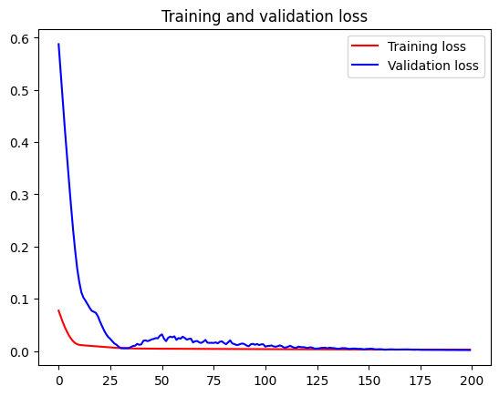
Plotting loss vs Validation loss
Notes:
Sam
By plotting both the training loss and validation loss on the same graph, we can see if they're decreasing together or if one starts to increase, indicating potential issues like overfitting.

Slide 21


Prediction
Model predicts and transform back to original form, to interpret the results in the original units of measurement.
Notes:
Sam LSTM model learned from a scaled and normalized data (to help it learn better). But for our interpretation, we need to convert the predictions back to actual Bitcoin price units (like USD) so we can easily understand and evaluate them.

Slide 22


Model Evaluation:
Mean Squared Error and R² score
Notes:
Sam MSE quantifies the difference between a model's predictions and actual values by squaring these differences; lower MSE means better performance. R² Score reveals how well the model explains price variation; a score of 1 means 100% explanation, while 0 is equivalent to always predicting the mean. Higher R² indicates a better model fit.

Slide 23
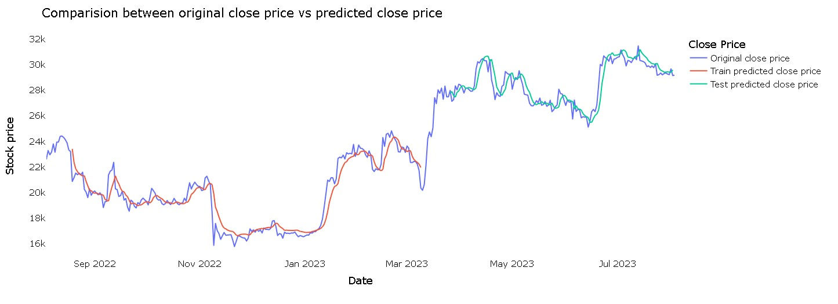
Notes:
Sam

Slide 24
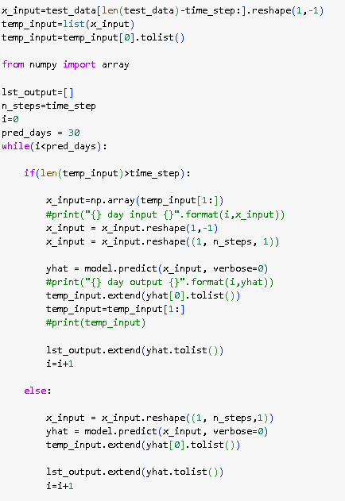
Predicting next 30 days
Notes:
vladimir

Slide 25
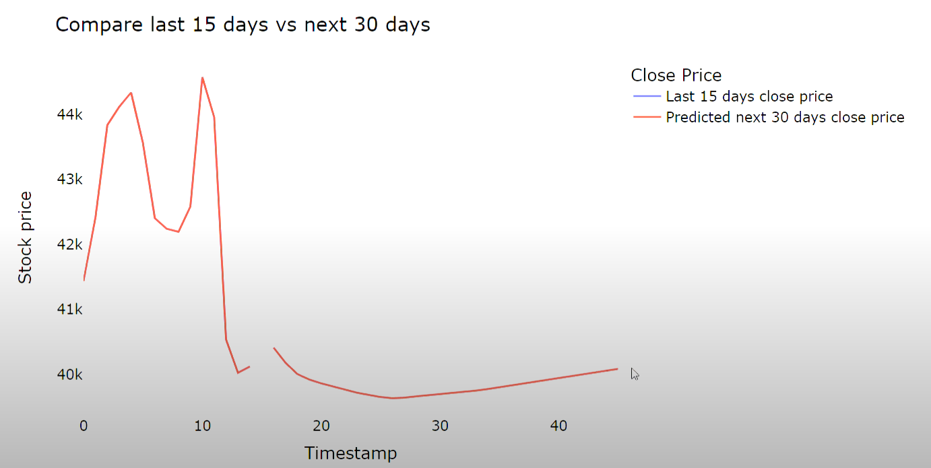
Compare last 15 days to next 30 days
Notes:
vladimir

Slide 26
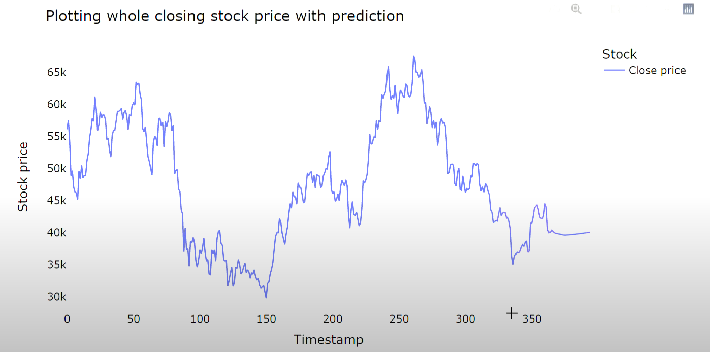
Final graphic with prediction
Notes:
vladimir

Slide 27
Ethical implications
How reliable is our model?
Not 100% accurate
Trust and responsibilities
Notes:
Vladimir

Slide 28
Ethical implications
How should we market our service?
Not FoolProof
Trust and responsibilities
Notes:
Vladimir

Slide 29
Ethical implications
Require a Terms and Conditions or Contract Signature in case users are dissatisfied or felt they were misled.
Trust and responsibilities
Notes:
Vladimir

Slide 30
Ethical implications
Customer awareness:
Inform consumers on how to use it and how we are improving processing pattern and parameters.
Trust and responsibilities
Notes:
Vladimir

Slide 31

Conclusion
The model is not accurate and needs improvements.
Increasing the amount of neural nodes, improve our data collection and iterate and refine the model.
We will have to be careful when marketing our service to no create unethical conflicts.

